Slide 1
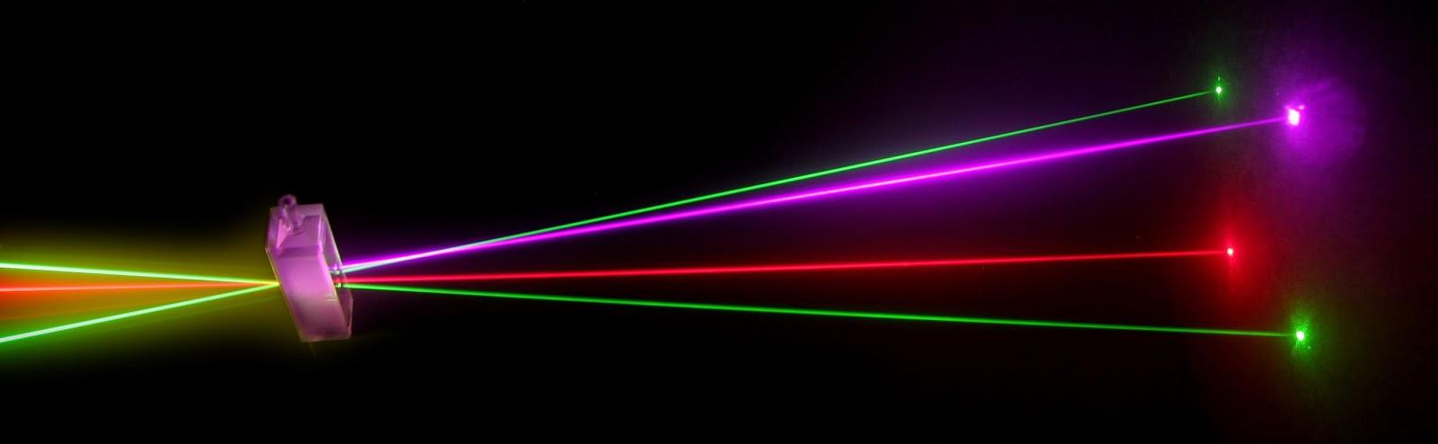
“Laser Technology and Applications” 16B1NPH533 [3 0 0]

Slide 2
Laser
An Acronym for
“Light Amplification by Stimulated Emission of Radiations”
One of the outstanding inventions of 20th century
A light source – but very much different from traditional light sources.
Not used for illumination purposes
Widely used as a high power EM beam rather than a light beam

Slide 3
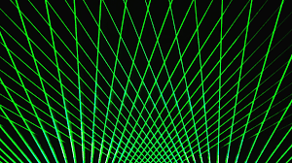

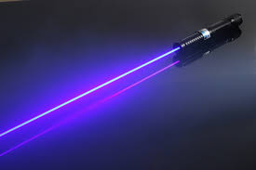
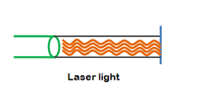
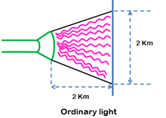
Common light source Vs laser
Many wavelengths
Multidirectional
Incoherent
Monochromatic
Coherent
Collimated
Directionality
Tunable
High Power

Slide 4
Lasers: A Walk Through History

Slide 5
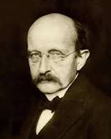
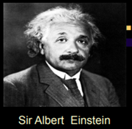
Laser History
Max Planck
In his most important work, published in 1900, Planck deduced the relationship between energy and the frequency of radiation, essentially saying that the energy could be emitted or absorbed only in discrete chunks-which he called quanta
Sir Albert Einstein
In1917, the first foundation of laser was set in by Sir Albert Einstein with the concept of Photons and Stimulated emission of radiations

Slide 6
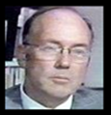
Laser History
Charles H Townes
1954: Working with some of his colleagues Herbert Ziegler and James Gordon, Townes demonstrates the first MASER at Columbia University. The ammonia maser, the first device based on Einstein's predictions.
1955: At P.N. Lebedev Physical Institute in Moscow, Nikolai G. Bosov and Alexender M. Prokhorov attempt to design and build oscillators. They propose a method for the production of a negative absorption that was called the pumping method.
1956: Nicolaas Bloembergen of Harvard University develops the microwave solid state maser.

Slide 7
Laser History
1958: Townes and his brother in law, Aurthur L. Schawlow, in a joint paper published in Physical Review, show that masers could be made to operate in the optical and infrared regions and propose how it could be accomplished.
At a conference in 1959, Gordon Gould published the term LASER in the paper The Laser, Light Amplification by Stimulated Emission of Radiation.

Slide 8
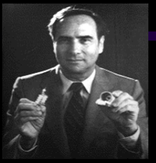
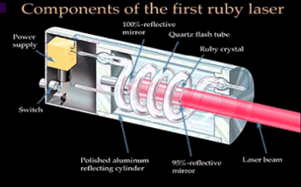
Laser History
Finally!!!!
Theodore H Maiman
May 16, 1960, Maiman, a physicist, constructs the first laser using cylinder of symmetric ruby measuring 1 cm in diameter and 2 cm long, with the ends silver coated to make them reflective and able to serve as Fabry-Perot Resonator. Maiman uses photographic flash lamps as the laser’s pump source.

Slide 9
Laser History
November 1960: Peter P. Sorokin and Mirek J. Stevenson demonstrate the Uranium laser, a four stage solid state device.
December 1960: Ali Jawan, William Bennett Jr. and Donald Herriot develop the He-Ne laser, the first to generate a continuous beam of light at 1.15 μm.
March 1961: At the second International Quantum Electronics meeting, Robert W. Hellwarth presents theoretical work suggesting that a dramatic improvement in the ruby laser could be made by making its pulse more predictable and controllable.
October 1961: Elias Snitzer reports the first operation of a neodymium glass(Nd:glass) laser.

Slide 10
Laser History
December 1961: the first medical treatment using a laser on a human patient is performed by Dr. Charles J. Campbell and Charles J. Koester. An Optical ruby laser is used to destroy a retinal tumor.
1962: With Fred J McClung, Hellwrath proves his laser theory, generating peak powers 100 times that of ordinary ruby lasers by using electrically switched Kerr cell shutters. The giat pulse formation technique is doubled Q-switching. Important first applications include the welding of springs for watches.

Slide 11
Laser History
October 1962: Nick Holonyak Jr.publishes his work on the “visible red” GaAsP (gallium arsenide phosphide) laser diode, a compact , efficient source of visible coherent light that is the basis for today’s red LEDs used in consumer products such as CD, DVD players and cell phones.
June 1962: Bell Labs reports the first yttrium aluminium garnet (YAG) laser.
1963: Logan E. Hargrove, Richard L. Fork and M.A. Pollack report the first demonstration of a mode locked laser. Mode locking is fundamental for laser communication and is the basis for femto-second lasers.

Slide 12
Laser History
1963: Herbert, and the team of Rudolf Kazarinov and Zhores Alferov, independetly propose ideas to build semiconductor lasers from heterostrucure devices. The work leads to Kroemer and Alferov winning the 2000 Nobel Prize in Physics.
March 1964 : William B. Bridges discovers the pulsed Argon-ion laser , which, although bulky and inefficient, could produce output at several visible and UV wavelengths.

Slide 13
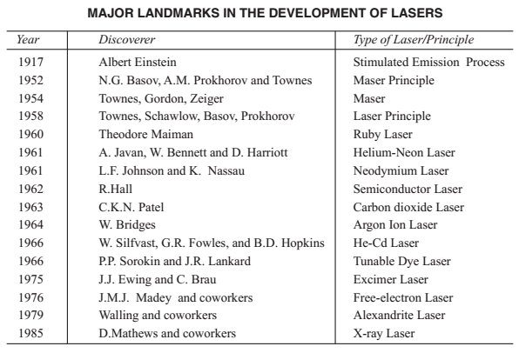

Slide 14
